Slide 1
Misstatement Detection Based on Virtual Pure Players
Keshing Ding
Xuan Peng
Miklos Vasarhelyi
Guangyue Zhang
Rutgers Business School

Slide 2
Motivation
Segment reporting guidance started in 1976 under US GAAP (SFAS No. 14)
Disclosures about segments of an enterprise and related information
A “management approach”
How management organizes the firm internally for making operating decisions and assessing performance
Provide additional comparability for financial reporting (Edmonds et al.,2018)
Clouds and reduces transparency around the mix and quality of the business and its related performance (CFA Institute)
Empirical evidence is needed to determine whether segment-level financial information provides incremental decision-useful information.

Slide 3
Goal of research
This paper studies whether breaking down multi-player firms to virtual pure players by segment SIC provides incremental value to misstatement prediction
Contributions
This study contributes to the literature on developing virtual pure players from conglomerates with SIC codes to improve the comparability of financial reporting and the accuracy of fraud prediction
This study also contributed to the standard-setting. Even with highly unregulated and discretionary segment-level financial information, a better-performing fraud detection model can be developed.

Slide 4
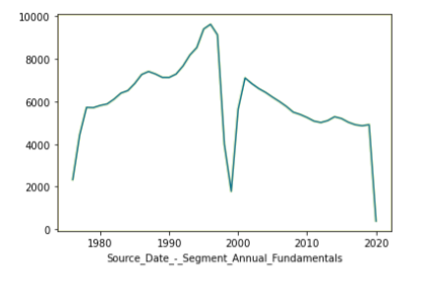
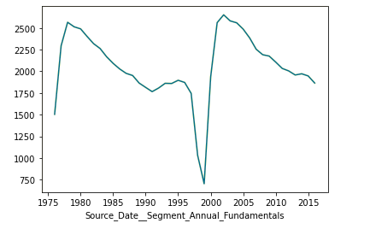
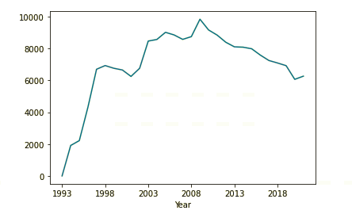
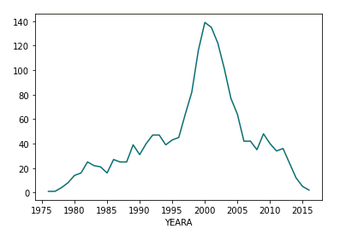
Descriptive data of segment-level information
How many companies are reporting business segments; how many are not single player
The number of companies reporting 10-k each year; the number of companies receiving AAER

Slide 5
Libby box
Dependent
Independent
Segment reporting quality and segment level financial information
Misstatement
External validity
Link 1
Link 2
Construct validity
Construct validity
Link 3
Dimension1 + Dimension 2
AAER
Link 4
Statistical conclusion validity

Slide 6
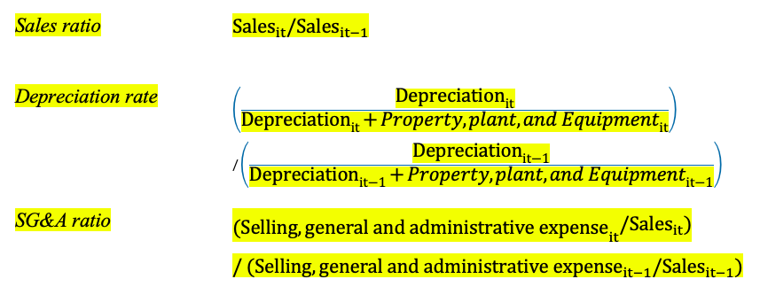
Operationalized independent variable
Dimensions Part 1: segment reporting quality
The average number of missing values of segment raw financial variable
The change in the reportable segment
Allocation of expenses and costs to corporate/other (Lail et al., 2014 )
Dimensions Part 2: segment level financial information
Financial ratios and raw financial variables
Winsorize and Calculate std from segment industry peer average
Take the maximum std from all segments

Slide 7
Discussion point - methodology
Likewise, segment information is quite crude. Firms only choose selected line items – not a full balance sheet or income statement. There are likely many costs at the corporate level that they do not allocate to specific segments. The corporate-level (unallocated costs that are not split up segment by segment) could be important sources of earnings management or misstatement.
Segment information is essential for assessing firm performance. The quality and informativeness of voluntary disclosure deserve an empirical test. We use both raw financial variables and financial ratios to make the most use of existing data.
We focus first on reporting quality indicators. Second on financial information, in terms of the deviation from virtual pure player peers
We use allocation of costs and expenses to corporate/other segment to account for managers taking advantage of vague cost allocation requirements.

Slide 8
Sample and data processing
Data source: business segment reporting from 2000-2016 from Compustat
Preprocessing:
Dropping firm-year observation without CIK number and SIC code
Set segment-level SIC code to two digits to ensure a reasonable sample size for each segment industry group
Missing value (missing reason: non-existent; not available yet; not applicable)
Drop the attribute and drop observations (Introduce some kind of bias in the model that is least intrusive )
Impute missing values for the continuous variable (imputation with mean or based on other attributes or Last observation carried forward (LOCF) )
The number of missing values as a new indicator
Using Algorithms that support missing values (RandomForest )

Slide 9
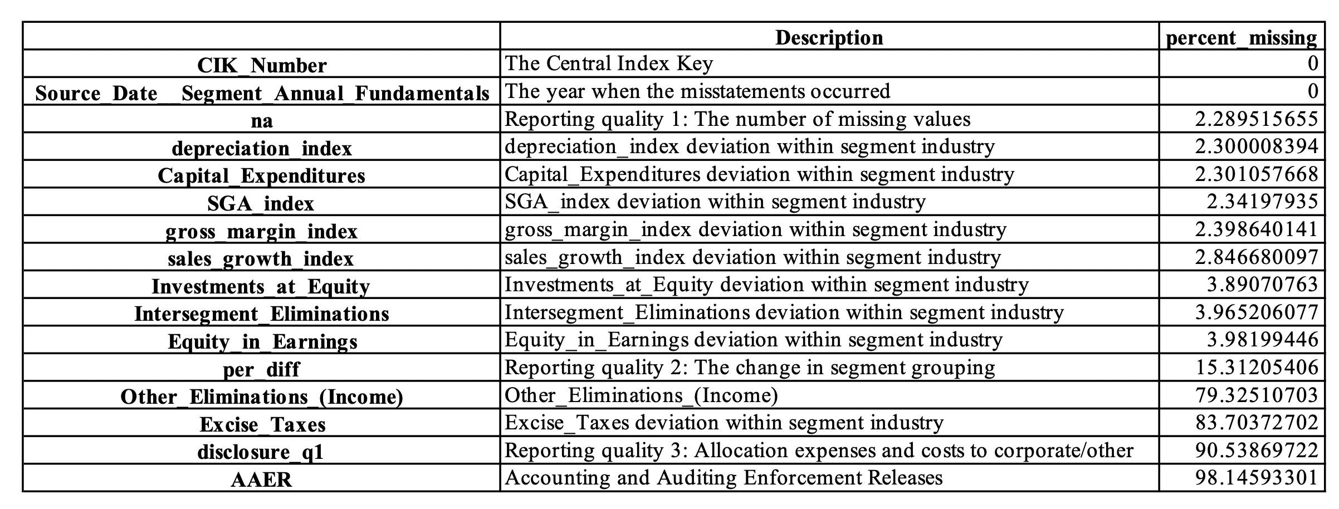
Sample and data processing
Dimensions Part 1 – firm-level
Dimensions Part 2 –take segment-level mean and transform to firm-level
Concatenate part1, Part2 - firm-level
Concatenate with AAER data with CIK number
Missing value processing

Slide 10
Machine learning model
Balanced Random Forest Classifier
Ensemble learning
Bagging of training data
Feature Randomness
Imbalanced data
Weighted bootstrap sampling

Slide 11
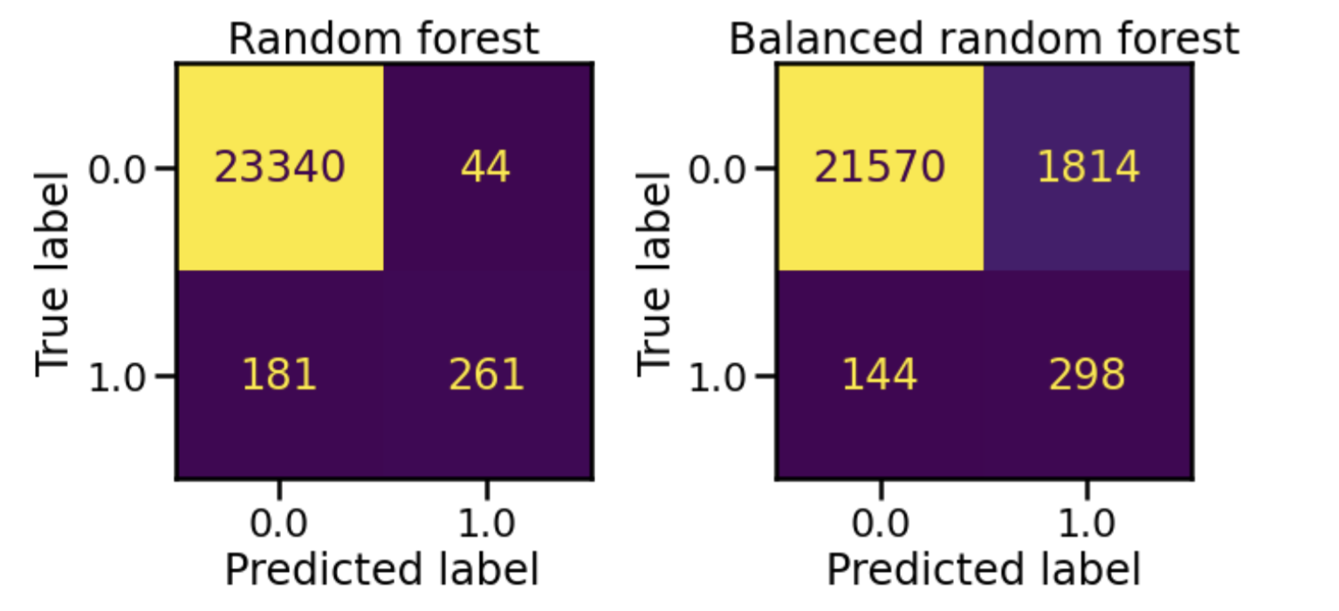
Results
Single decision tree
Random forest classifier without sampling
Balanced Random forest classifier with sampling

Slide 12
Limitations and future research
The empirical results of this paper are limited to firms providing business segment reporting
More research on the characteristics of firms that offer different segment reporting quality
More research is needed for explaining the model results
In-sample and out-of-sample results
Include firm-level accrual quality, financial performance, non-financial measures, off-balance-sheet activities, and market-based measures to examine the incremental value of segment reporting (?)

Slide 13
Thanks for listening
13

